Slide 1
Bandwidth and Propagation Delay Exercises ANS
Links
Bandwidth and Propagation Delay
Pipe Diagrams
Overloaded Links
Lecture 3, Spring 2026
Notes:
so here's the outline we're going
38:16
to start by talking about links in a lot of detail think about how you measure the performance of links what makes a
38:21
link good what makes a link bad what are the trade-offs we'll talk about what happens if links get overloaded and then
38:27
the very end now that we finished all of the introduction I can actually give you a preview of all the topics you're going
38:33
to see in a lot more detail so these three sets of lectures have really been about giving you a highlevel 10,000 foot
38:39
picture of what you're going to see this semester and then at the very end I'll show you the exact places where we'll be
38:45
really diving in and talking about things in lots more detail but before we get there let's not get ahead of
38:50
ourselves let's start with talking about links and how to measure their performanc

Slide 2

Packet delay: four sources
IMPORTANT
transmission
A
propagation
The nodal processing delay (check bit errors, determine output link) is typically very small and can be ignored
B
queueing
d_{nodal} = d_{queue} + d_{trans} + d_{prop}
d_{q}: queueing delay
time waiting at output link for transmission
depends on congestion level of router
d_{tx}: transmission delay:
L: packet length (bits)
R: link transmission rate (bps)
d_{trans} = L/R
d_{prop}: propagation delay:
d: length of physical link
s: propagation speed (~2x10⁸ m/sec)
d_{prop} = d/s
Notes:
d_{proc}: nodal processing
check bit errors
determine output linknodal processing
typically < microsecs

Slide 3
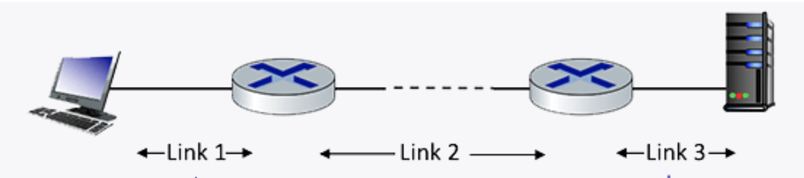
Q1 End-­to­‐end delay
Consider the network shown in the figure, with three links, each with a transmission rate of 1 Mbps, and a propagation delay of 1 msec per link. Assume the length of a packet is 1000 bits.
What is the end-end delay of a packet from when it first begins transmission on link 1, until is it received in full by the server at the end of link 3. Assume that queueing delays are zero.
Notes:
Each link has transmission delay 1000 bits/1 Mbps = 1ms. So each link has total delay of transmission + propagation = 1+1=2 ms.
For the three links, the total delay = 2 + 2 + 2 = 6 ms. `

Slide 4
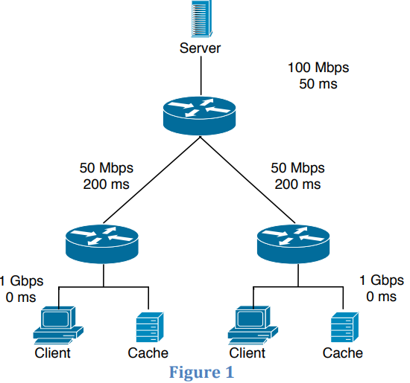
Q2 End-­to­‐end delay
Consider the scenario shown in Figure 1: a server is connected to a router by a 100Mbps link with a 50ms propagation delay. This router is connected to two other routers, each over a 50Mbps link with a 200ms propagation delay. A 1Gbps link connects each host to each of these routers with 0 propagation delay. All packets in the network have size of 20,000 bits.
What is the end-­to­‐end delay (in ms) from when a packet is transmitted by the server to when it is received by the client? Assume there’s no queuing delay at the routers.

Slide 5

Q3 End-­to­‐end delay
Consider a 100 Mbps link between an earth station (sender) and a satellite (receiver) at an altitude of 2100 km. The signal propagates at a speed of $3×{10}^{8}$m/s. Calculate the time taken (in ms) for the receiver to receive a packet of 1000 bytes transmitted by the sender. (There is no router so there is no queuing delay.)

Slide 6

Q4 End-­to­‐end delay
Consider two computers X and Y connected via a single link of bandwidth 512 Gbps. Suppose that both hosts are separated by distance M meters, and the propagation delay along the link is $2×{10}^{9}$meters/sec. Computer X has to send a packet of size 1 Kbyte to computer Y. What will be the distance M such that the propagation delay is equal to the transmission delay?

Slide 7

Q5 Transmission delay
1. Calculate transmission delay for message size $L=8000$bits, network bandwidth $B=8000$bits/sec
ANS:
2. Calculate transmission delay for message size $L=\text{1} \text{Kbyte}\text{s}$, network bandwidth $B=8 \text{Kbps}$
ANS:
Notes:
Computer Networks 14 | Delay in Computer Network | CS & IT | GATE Crash Course
https://www.youtube.com/watch?v=vXyNFzq7Ixc&list=PL3eEXnCBViH-hlNCNwdfV7VrEcTquANGa&index=15

Slide 8
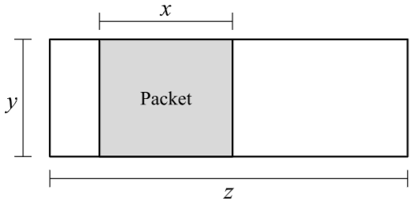
Q5.1 Pipe Diagram
Consider the pipe diagram, with a single packet in the pipe.
1) What is the size of this packet?
2) How long does it take to send a packet of the same size as the packet shown?(Count from the time the first byte is sent, to the time the last byte is received.)
3) How long does it take to send 7 packets, all of the same size as the packet shown?(Count from the time the first byte of the first packet is sent, to the time the last byte of the last packet is received.)
4) What is the maximum number of packets that could be in the process of being sent alongthis link, at any given moment?Don’t worry about fractions and rounding (e.g. assume 𝑥, 𝑦, and 𝑧 are defined such that all answerchoices are integers).

Slide 9
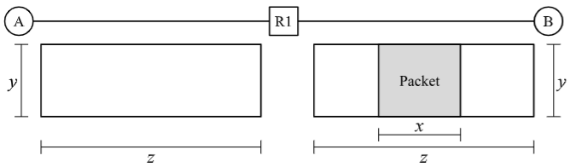
Q5.2 Pipe Diagram
Now, consider the network topology with a Router R1, which has an infinite-size queue, and R1 continually processes packets in its queue in FIFO order. R1 can only start transmitting a packet once it has received the entire packet. All packets are the same size as the packet shown in the diagram in Q5.1. A wants to send a packet to B. No other packets are being sent along the links (i.e. suppose the packet in the diagram is not there).In the next two subparts, select how long it takes to send the packet from A to B. Count from the time the first byte of the packet is sent at A, to the time the last byte of the packet is received at B.
5) In this subpart, suppose R1 has 1 other packet in its queue when A sends the packet. How long does it take to send a single packet from A to B?
6) In this subpart, suppose R1 has 20 other packets in its queue when A sends the packet. How long does it take to send a single packet from A to B? Assume that the queue at R1 is notempty when this packet arrives at R1.
7) What is the maximum number of packets that can be queued at R1, such that when thelast byte of the A-to-B packet reaches R1, there is no queue at R1? Don’t worry about fractions and rounding (e.g. assume 𝑥, 𝑦, and 𝑧 are defined such that all results of division are integers.)

